Slide 1

FACE MASK DETECTION using CNN
MENTOR : PROF. SNEHAL ANDHARE
TEAM MEMBERS :
1) SARVESH GUDA – 19102A0007
2) JAPLEEN SINGH – 19102A0002
3) HARSH PANDITA – 19102A0040

Slide 2
INTRODUCTION/BACKGROUND
In 2020, due to the rapid spreading of covid-19, the World Health Organization has declared covid-19 as a global pandemic. Due to this contagious deadly virus, many people have lost their lives and there is also a massive damage in global economy and even unemployment has increased. In order to prevent or keep this situation in control, wearing a face mask has become very important. Many studies have proved that wearing a face mask helps to prevent the transmission of covid-19
The proposed model can be integrated with surveillance cameras to impede the COVID-19 transmission by allowing the detection of people who are wearing masks not wearing face masks. The model is integration between deep learning and classical machine learning techniques with OpenCV and Keras.

Slide 3
PROBLEM STATEMENT
The main objective of the face detection model is to detect the face of individuals and conclude whether they are wearing masks or not at that particular moment when they are captured in the image.

Slide 4
PROJECT OBJECTIVES
The main purpose of this system is to collect with mask and without mask datasets from online resources in order to create a face mask identification model using CNN deep learning classifier. Face mask recognition from a live web cam is possible with this face mask detector.

Slide 5
PROPOSED SYSTEM
1. This system is capable to train the dataset of both persons wearing masks and without wearing masks.
2. After training the model the system can predict whether the person is wearing the mask or not.
3. It also can access the webcam and predict the result.

Slide 6
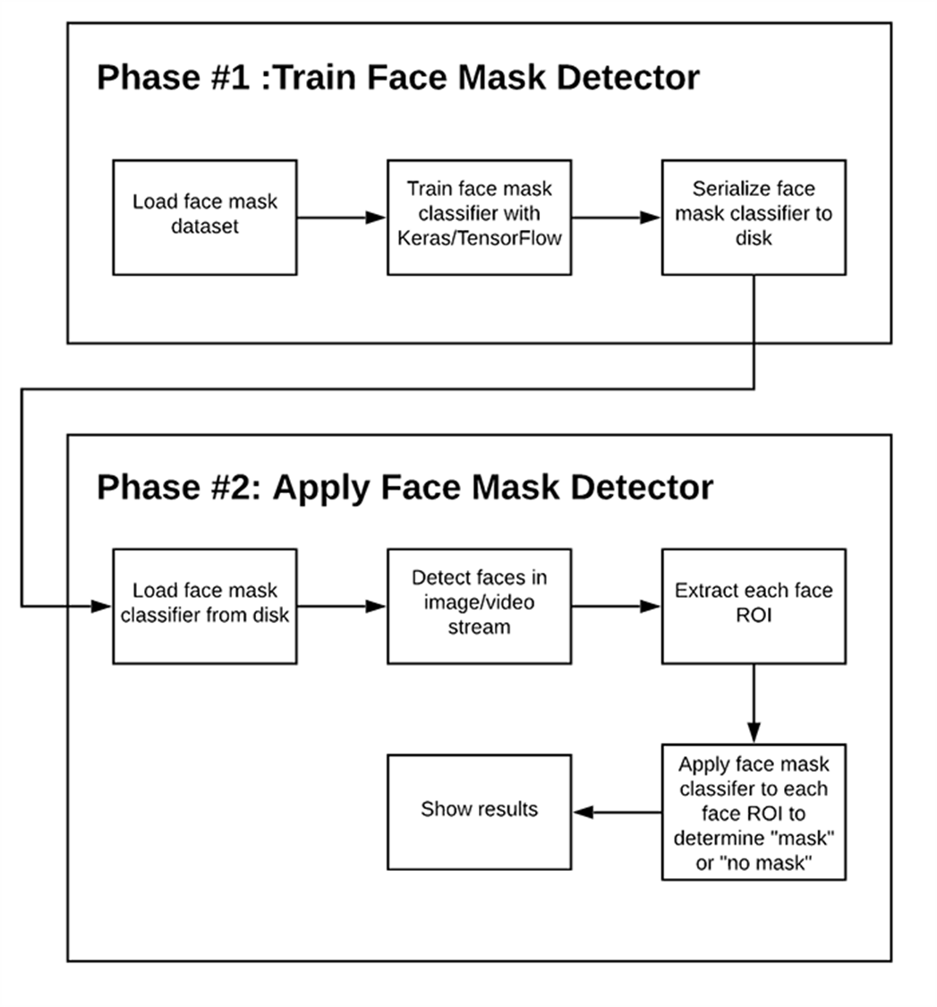
FLOW CHART OF FACE MASK DETECTOR

Slide 7
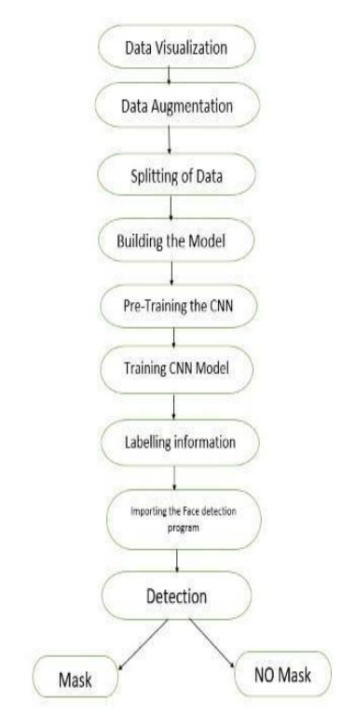
METHODology
Data Visualization: In the first step, let us visualize the total number of images in our dataset in both categories. We can see that there are 10,815 images in the ‘with mask’ folder and 10,383 images in the ‘without mask’ folder.
Data Augmentation: In the next step, we augment our dataset to include more number of images for our training. In this step of data augmentation, we rotate and flip each of the images in our dataset.
Splitting of Data: In this step, we split our data into the training set which will contain the images on which the CNN model will be trained and the test set with the images on which our model will be tested and valid dataset.
Training data : WITH MASK images – 10,815
WITHOUT MASK images- 10,383
Valid data : WITH MASK images – 853
WITHOUT MASK images – 753
Test data : WITH MASK mages – 496
WITHOUT MASK images- 530

Slide 8
METHODology
Training the CNN model: This step is the main step where we fit our images in the training set and the test set to our Sequential model we built using keras library. I have trained the model for 30 epochs (iterations). However, we can train for more number of epochs to attain higher accuracy Test there occurs over-fitting.
Importing the Face detection Program: After this, we intend to use it to detect if we are wearing a face mask using our PC’s webcam. For this, first, we need to implement face detection. In this, I am using the Haar Feature-based Cascade Classifiers for detecting the features of the face.
Detecting the Faces with and without Masks: In the last step, we use the OpenCV library to run an infinite loop to use our web camera in which we detect the face using the Cascade Classifier

Slide 9
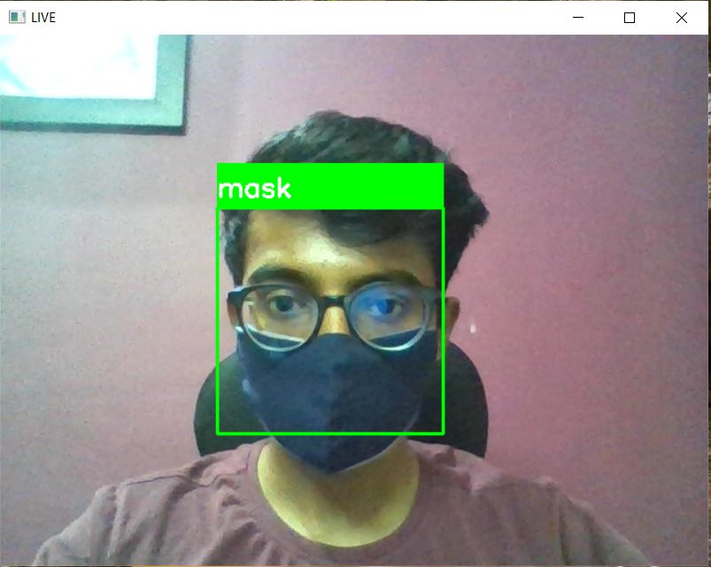
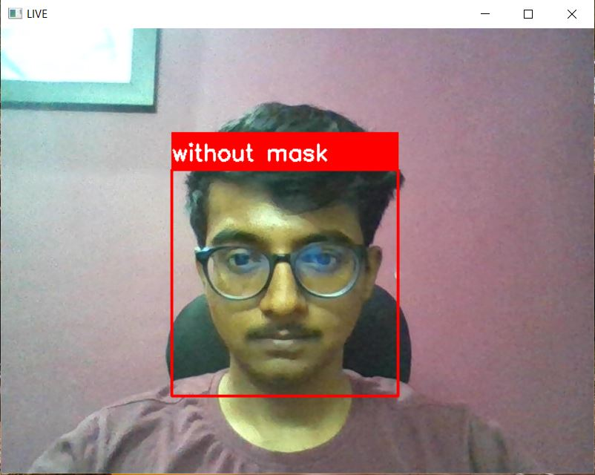
RESULTS

Slide 10
Observations and discussionS
As technology advances, new trends emerge, such as the revolutionary face mask detector, which may contribute to public healthcare. The model is trained on a real world dataset. To determine whether or not persons were wearing face masks, we utilized OpenCV, Keras and CNN.

Slide 11
Future scope
Integrate the person identification model and face mask detection model into a single detection algorithm.
Integrating them with automated thermal detection systems.
Integrate it with Social Distancing systems.

